Slide 1
ROBOTICS
Robotics is the interdisciplinary field that integrates mechanical engineering, electrical engineering, and computer science to design, build, and operate robots.

Slide 2
The Giants of Industrial Robotics
COMPANY | SHARE
ABB | 21%
KAWASAKI | 9%
KUKA | 9%
EPSON | 3%
FANUC | 8%

Slide 3
INVESTMENT IN ROBOTICS
YEAR | INVESTMENT9 (IN $B)
2021 | 276.1
2022 | 189.6
2023 | 200.7
2024 | 250.8

Slide 4
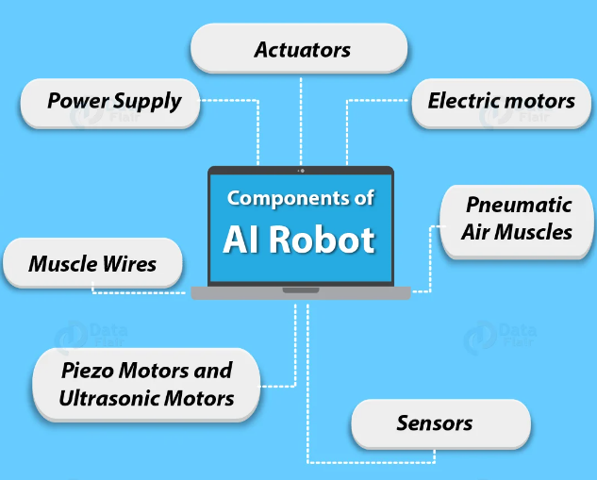
: Key Components of Robots
Sensors: Gather data about the robot’s environment (e.g., cameras, lidar).
Actuators: Move and control the robot’s limbs and parts (e.g., motors, servos).
Controller: The “brain” of the robot, which processes inputs and makes decisions.
Power Supply: Provides energy for the robot’s operation.
Software: Programs that control the robot's actions and responses.

Slide 5
UPCOMING ROBOTS
AIBO
UR 10
RoBoHon
Nimble

